Slide 1

CWB – Accounting Dashboard
17-September-2020

Slide 2

Predictive Cash Flow (XAI)
TOP POSITIVE CASH FLOW GROWTH DRIVERS
Low 3-month average expense ($3782)
Low 3-month difference expense ($3782)
3 months
Low 6-month average expense ($3782)
High 6-month difference in income ($3782)
TOP NEGATIVE CASH FLOW GROWTH DRIVERS
Low 1-month difference in income ($3782)
High 1-month difference in expense (-$3782)
High 6-month difference in expense (-$3782)
Low 6-month average income ($3782)
Very Low Profit after Tax

Slide 3
Predictive Cash Flow (XAI)
TOP POSITIVE CASH FLOW GROWTH DRIVERS
Low 3-month average expense ($3782)
Low 3-month difference expense ($3782)
3 months
Low 6-month average expense ($3782)
High 6-month difference in income ($3782)
TOP NEGATIVE CASH FLOW GROWTH DRIVERS
Low 1-month difference in income ($3782)
High 1-month difference in expense (-$3782)
High 6-month difference in expense (-$3782)
Low 6-month average income ($3782)
Very Low Profit after Tax

Slide 4
Cashflow Prediction Model
Will be built on Core banking data and Moody’s SME related information to predict the Next Month Net Disposable Income or % of Change of Net Disposable Income
The prediction can be imputed for the following 2 months providing a longer term perspective
Provide Reasons behind each prediction to allow Actionable Insights

Slide 5
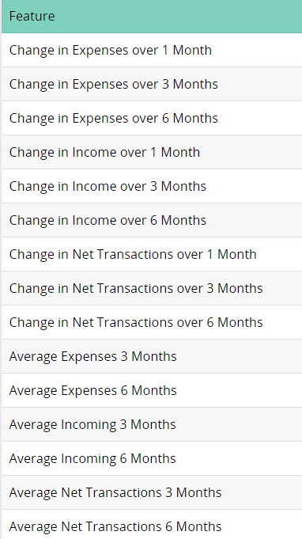
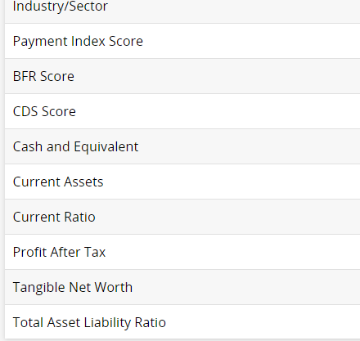
Possible Features

Slide 6
CODAT Data
One interim possible solution will involved supplying the Codat accounting and company data to the generated model to generate the needed prediction
To allow this, we need to sample CODAT data for 2 or more SME which will enable us to compare against the SME data we have for core banking and company related information. This will allow us to calibrate the model accordingly
In the future once we have accumulated enough SME data based on Codat data, the model could be regenerated based on CODAT data

Slide 7
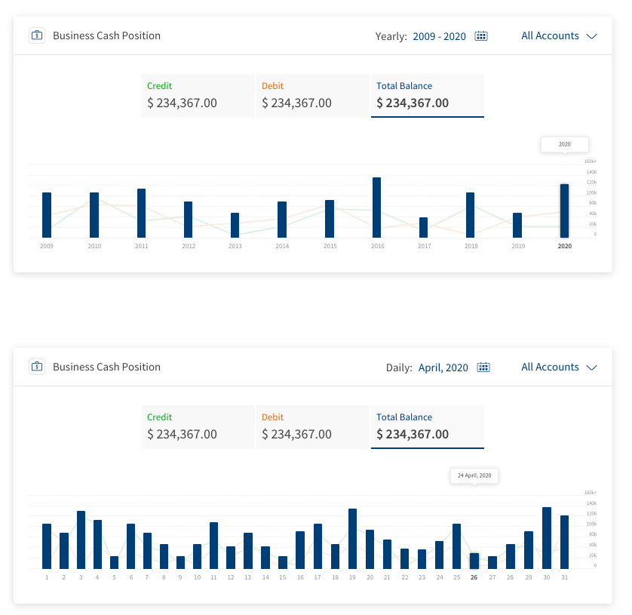
Cash Position
Description

Slide 8
Cash Flow
Aggregated data provided by CODAT
Date range options could be Last month, Last 3 months, Last 6 months, Last Year or a custom date range
Last Month
All Accounts
Cash Receipts
Cash Payments
$ 10,759
$ 10,759

Slide 9
Payables & Receivables - Summary
Aggregation required
RECEIVABLES
Overdue Receivables
Overdue Invoices
20.05 %
20.05 %
$ 10,759
123
Total Outstanding Receivables
Outstanding Invoices
$ 120,759
1979
PAYABLES
Overdue Amount
Overdue Bills
20.05 %
20.05 %
$ 10,759
21
Total Outstanding Amount
Outstanding Bills
$ 120,759
129

Slide 10
Payables & Receivables - Overdue
Aggregation required

Slide 11
Payable & Receivables – By Supplier / Customer
Aggregation required
Receivables by Customer
Amount due
Outstanding Invoices
View All
View All

Slide 12
Receivables – By Customer
Aggregation required
Receivables by Customer
Amount % ledger
Average Debtor Days
View All
View All

Slide 13
Payables & Receivables – Future Due
Aggregation required
Future Due Receivables
Future Receivables by Customer
Next 30 days
16th October 2020
$ 10,759 (20.05 %)
Click through to view all invoices (Invoice No, Amount, Due Date, Raised, Due Amount)
Click through to view full list of customers
View All

Slide 14
Customers & Suppliers
Aggregated data provided by CODAT
Outstanding Invoices
Average Debtor Days
Total Owed
$ 10,759
205
50.2 days
ALL CUSTOMERS
Customer Name | Total Owed | Average debtor days | Outstanding Invoices | % Ledger
Customer Name | 0-10 day | 10 – 30 days | 30 – 60 days | > 60 days
AGED DEBTORS
Customer Name
Aggregation required
Last 4 months
Customer since – dd/mm/yyy

Slide 15
Estimation
Use Case | Effort (Man Days) | Activities & Assumptions
Display Cash Flow prediction (XAI) | 15 | Integrate with XAI API to fetch Cash flow prediction and factors contributing to the prediction Create UI Visualization to represent the data graphically in MB & OLB
Display Cash Position chart | 5 | Integrate with TDL API to fetch money-in, money-out and available balance information by duration and account types Display information in Cash Position tile available in Base Infinity product
Accounting Dashboard – Visualizations | 95 | Integrate with CODAT & TDL APIs to fetch data for different Visualizations Create UI Visualization to represent the data graphically in MB & OLB
Entitlement changes | 12 | Extend the Entitlement framework to support new features by Business Customer roles defined in Spotlight
Consent Management | 35 | Integrate with CODAT APIs for Authorization and consent management Create 5-6 UI Screens on Mobile Banking (MB) & Online Banking (OLB) Assuming Mule soft layer will store User consent data and use for pulling & pushing the data between CODAT & TDL
QA Effort | 90
Total | 252

Slide 16
CWB Support Requirements
To deliver the architecture and functionality as described we will need support from CWB to provide:
Infrastructure as specified by Mark Terry in his stream
Bank SME expertise in support of dashboard design and insights/APIs required
Bank SME expertise in validating the cash flow model

